Slide 1
Project Pre Proposal
Adnan Patel
Abhilash Kashyap Balasubramanyam
Instructed by: Dr. Saniie
ECE 510 Summer 2024
5/22/2024

Slide 2
The Team
Adnan Patel
M.S. Electrical Engineering
Focus in VLSI construct and circuit building.
Abhilash Kashyap Balasubramanyam
Master of Engineering in Artificial Intelligence for Computer Vision and Control

Slide 3
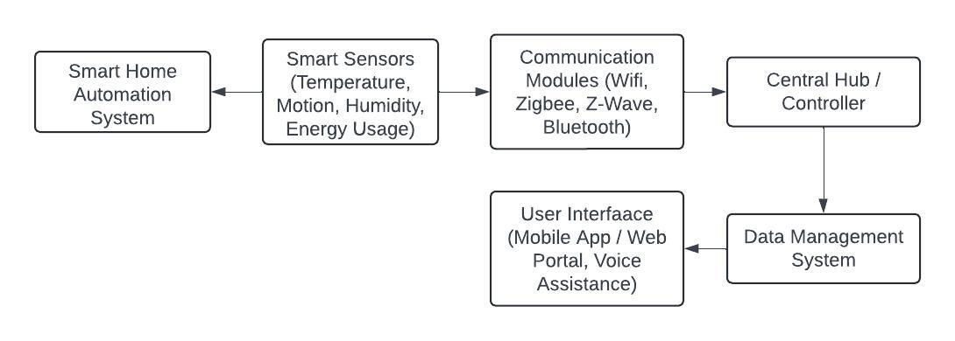
Automation System

Slide 4
Proposed Feature Ideas
Wireless Flood Detection System:
Smart Wheelchair
Smart Cradle System
Gesture Controlled Switch
IOT based Parking System

Slide 5
Use Cases
Smart Agricultural Monitoring
Smart Energy Management
Automation System
Asset Tracking and Management

Slide 6
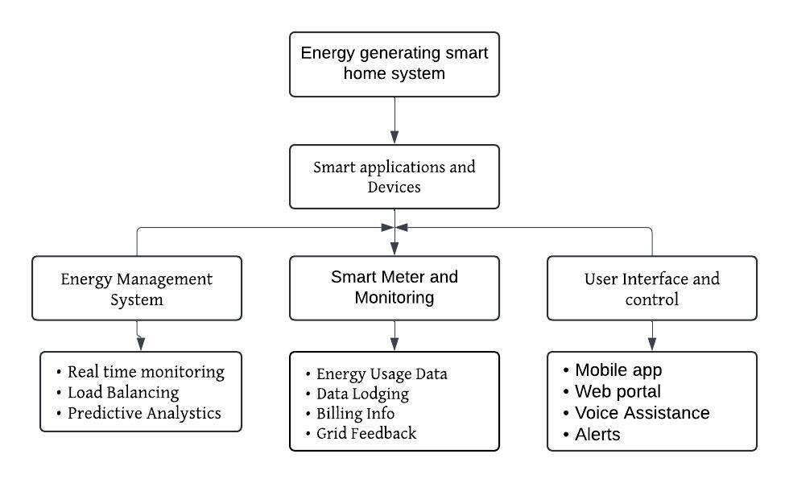
Smart Energy Management System

Slide 7
Use Cases
Energy Generation
Integration with Smart Homes
Sustainability
Scalability
Unused Potential

Slide 8
Use Cases
Integration with Public Buildings
Application at a Gym
Smart Energy Management System
Military Uses

Slide 9
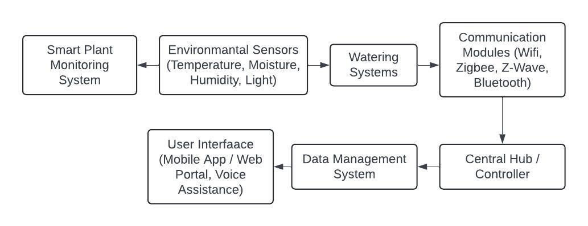
Smart Plant Monitoring System

Slide 10
Proposed Feature Ideas
Real Time Monitoring
Remote accessibility
Alarms and notifications
Data-driven insights
Water and energy conservation

Slide 11
Used Cases
Smart Agriculture
Research and Education
Smart Plant Monitoring System
Urban Gardening

Slide 12
Thank you

